Slide 1







Predict Energy Behavior of
Prosumer
sagemcom

Slide 2





Content
weather analysis
consumption analysis
production analysis
aproach statistics
Importance of features

Slide 3

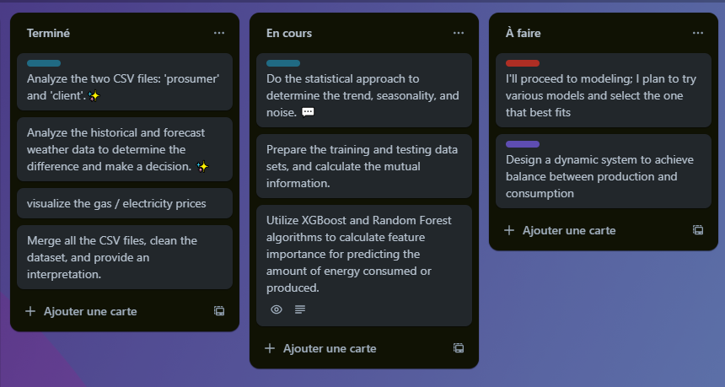
kanban board

Slide 4
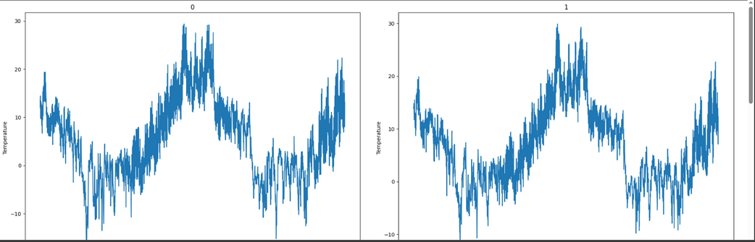

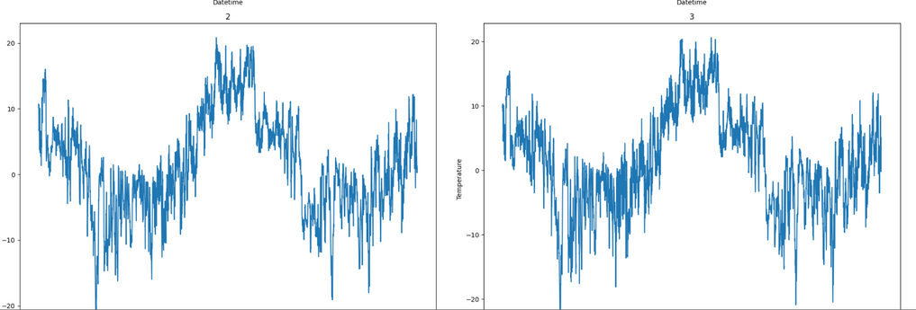
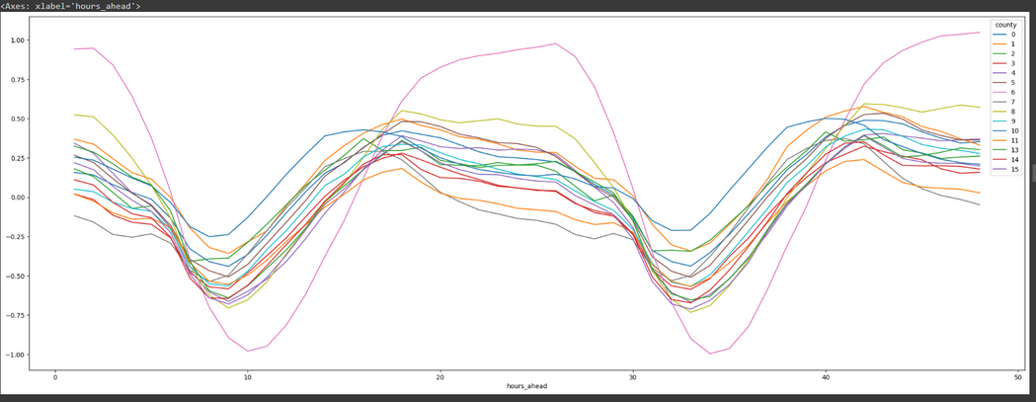
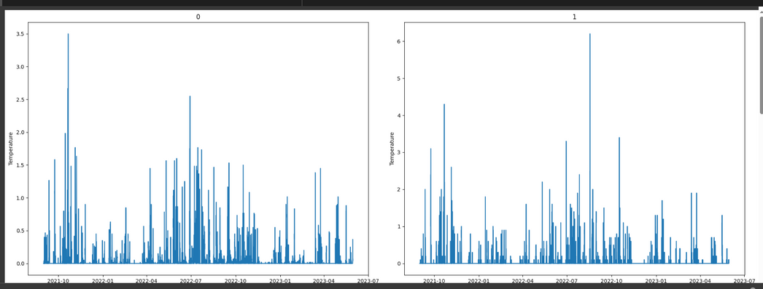
weather
temperature of each county as function of time
dewpoint of each county as function of time
temperature difference based on the original date and forecast date
rain of each county as function of time

Slide 5
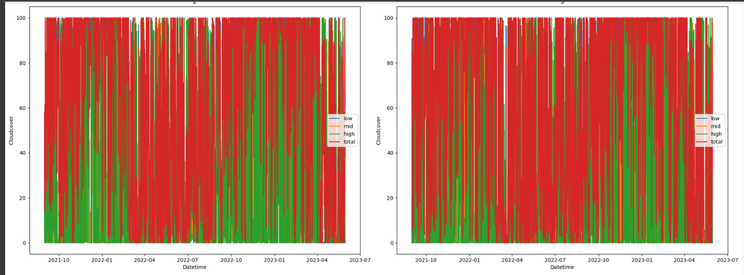
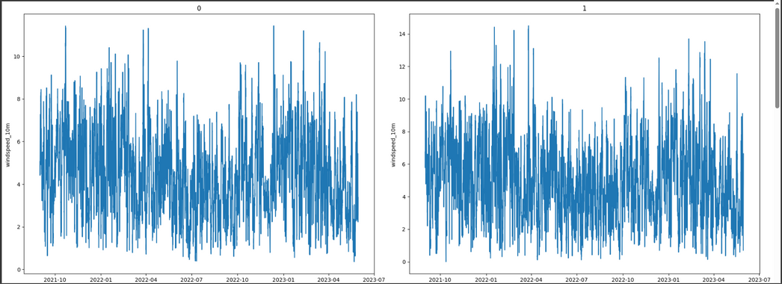
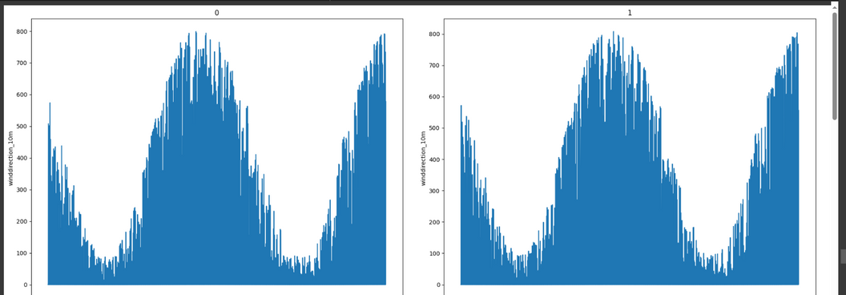
weather
cloudcove of each county as function of time
windspeed of each county as function of time
temperature difference based on the original date and forecast date
shortwave_radiation of each county as function of time

Slide 6

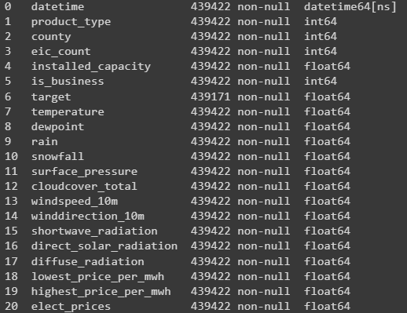
Merge the Dataset
production.csv
consommation.csv

Slide 7

1/ Consumption analysis
1. Feature creation
2. Statistical approach
3. Mutual information
4. Utilizing XGBoost and Random
Forest for feature classification

Slide 8

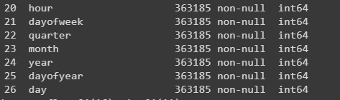
Feature Creation
I've created a new feature that captures the significance of consumption at different hours and days. We believe this information will be valuable for training our model

Slide 9
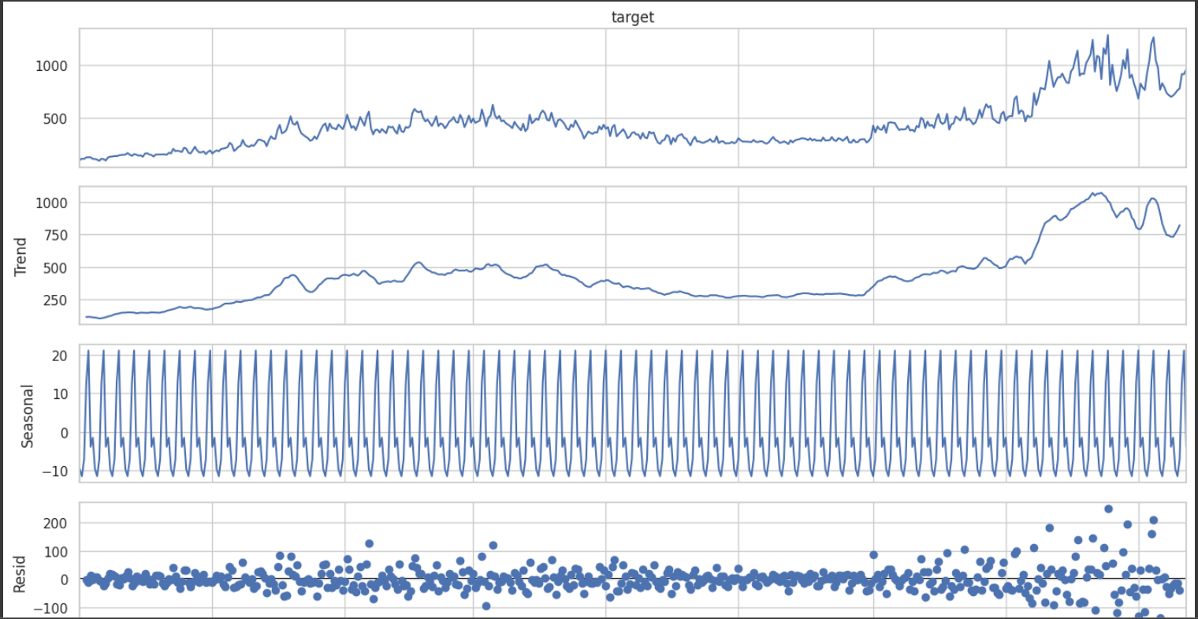
Statistical approach
decomposition for each client the evolution of target into: trend and seasonal and reside

Slide 10
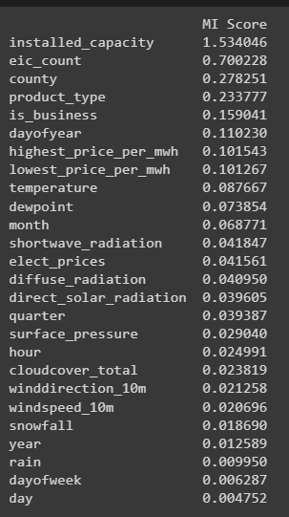
Mutual information
The mutual information determine the importance of features with respect to a target variable, especially in the context of feature selection or feature ranking in machine learning tasks.

Slide 11


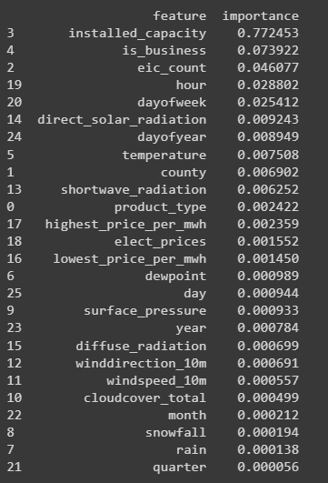
Utilizing Random Forest for feature classification
Random Forest calculates feature importance based on how much each feature decreases impurity in the decision trees (e.g., Gini impurity or entropy). The more a feature reduces impurity when making decisions in the trees, the more important it is considered. The importance of features is calculated during the training phase of the Random Forest algorithm.

Slide 12
2/Production analysis
1. Feature creation
2. Statistical approach
3. Mutual information
4. Utilization of XGBoost and Random Forest for feature classification

Slide 13
Feature Creation
I create a new feature that importante and can be useful for training our model , inn fact we assume that there are hours when the counsuption is importante and also day
reallygreatsite.com

Slide 14
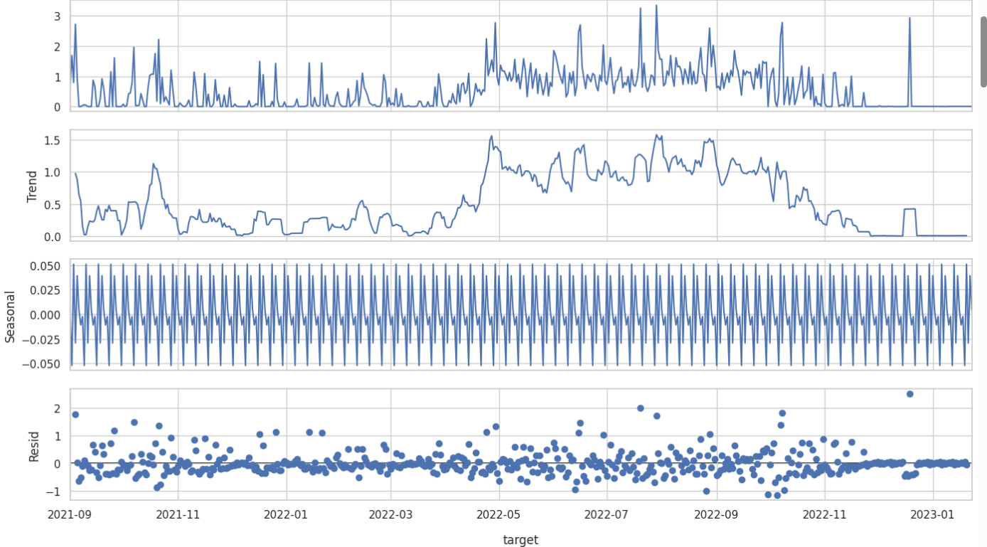
Statistical approach
decomposition for each client the evolution of target into: trend and seasonal and reside

Slide 15
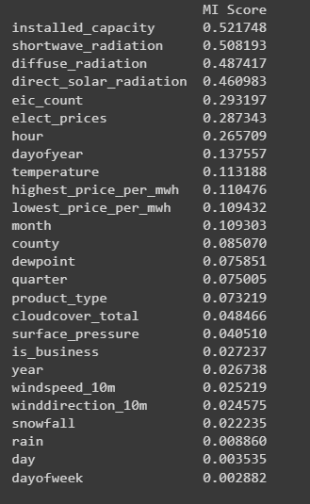
Mutual information
The mutual information determine the importance of features with respect to a target variable, especially in the context of feature selection or feature ranking in machine learning tasks.

Slide 16
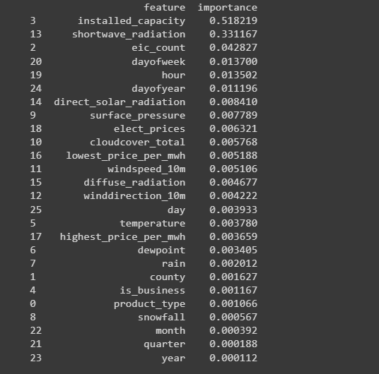
Utilization of Random Forest for feature classification
Random Forest calculates feature importance based on how much each feature decreases impurity in the decision trees (e.g., Gini impurity or entropy). The more a feature reduces impurity when making decisions in the trees, the more important it is considered. The importance of features is calculated during the training phase of the Random Forest algorithm

Slide 17
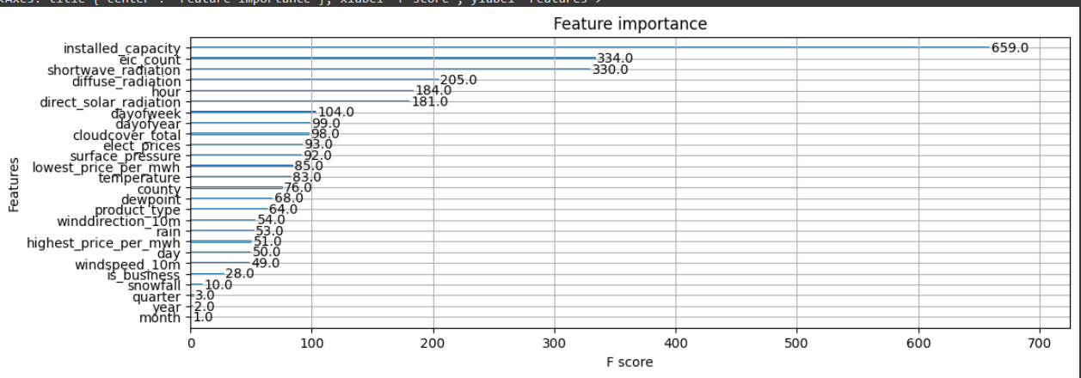
Utilization of XGBOOST for feature classification
Feature importance in XGBoost is calculated based on how frequently each feature is used in decision trees across all boosting rounds and how much it contributes to reducing the loss function. Features that are frequently used early in the boosting process and contribute substantially to reducing the loss are considered more important.

Slide 18
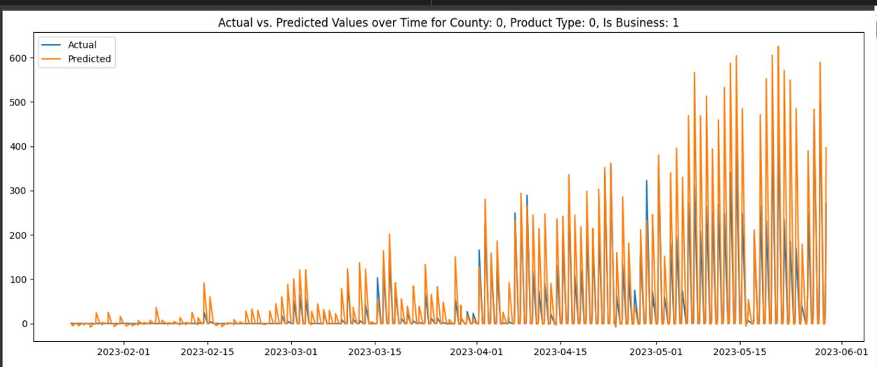
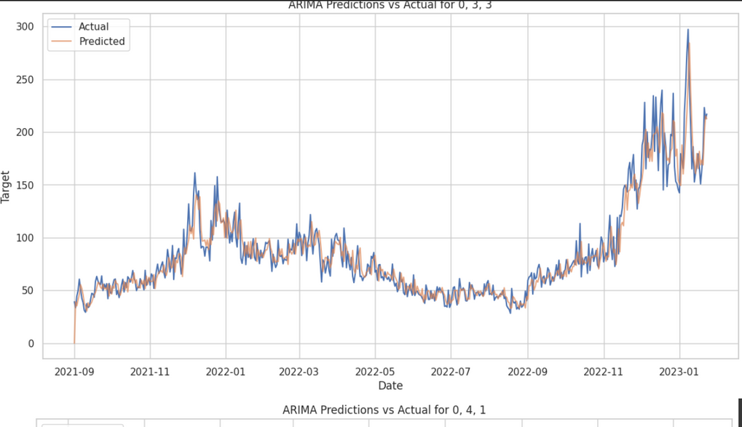
using ARIMA AND SARIMA FOR PREDICTION
PRODUCTION
CONSUMPTION

Slide 19


Thank You!

Slide 20
Predict Energy Behavior of
Prosumer
sagemcom

Slide 21
Content
data representation
LGBM
LSTM
ARIMA & LSTM

Slide 22
1/ Data representation
1. rappel for my data

Slide 23
Statistical approach
decomposition for each client the evolution of target into: trend and seasonal and reside

Slide 24
Statistical approach
decomposition for each client the evolution of target into: trend and seasonal and reside

Slide 25
using ARIMA AND SARIMA FOR PREDICTION
PRODUCTION
CONSUMPTION

Slide 26

PROBLEM
datetime | client_id | weather | target
2023/02/01 00:00:00 | 23 | * * | 100
2023/02/01 00:00:00 | 24 | * * | 200
2023/02/01 00:00:00 | 25 | * * | 50
For each client ID, I will create a separate dataframe to work with. The issue at hand is the size of our dataset, which comprises 6946 rows.

Slide 27

MODELING

Slide 28
2/ LGBM
1. architecture
2. Optimization
3.Evaluation
Idea source: previous works for the competition

Slide 29
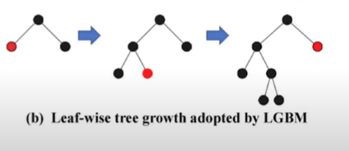
1/ Architechture
Tree-based Learning Algorithms
LightGBM uses a tree-based learning algorithm that grows trees vertically (leaf-wise) rather than horizontally (level-wise) as seen in many other boosting frameworks. This means it chooses the leaf with the highest loss to grow, aiming at reducing more loss compared to growing level-wise

Slide 30
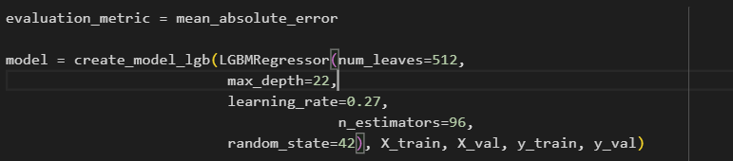
1/ Architechture
num_leaves: The maximum number of leaves in one tree. Setting it to 512 allows the model to make finer splits but can lead to overfitting if not careful.
max_depth: The maximum depth of a tree. A depth of 22 ensures the model can learn complex patterns by building deep trees.
learning_rate: This controls the step size at each iteration while moving toward a minimum of a loss function. A learning rate of 0.27 is relatively high, which can make the training process faster but might overshoot the minimum if too high.
n_estimators: The number of boosting trees to use, set to 96. This specifies how many times the boosting process is repeated, with each successive model correcting errors made by previous ones.
random_state: Ensures reproducibility of results by providing a seed to the random number generator.

Slide 31
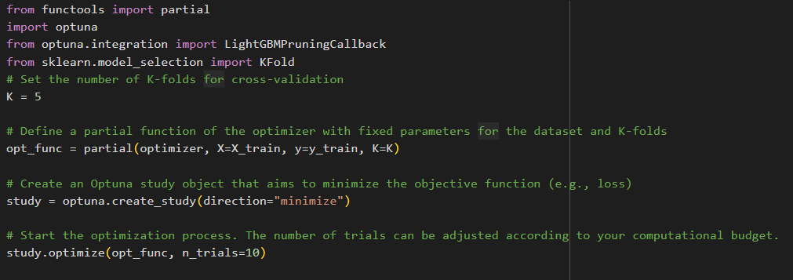
2/Optimization
the optimization process, where Optuna will call the opt_func function multiple times (10 trials in this case). In each trial, Optuna suggests a new set of hyperparameters, evaluates the model's performance through the partial function (opt_func), and then attempts to minimize the average loss over the specified number of trials. Optuna automatically adjusts its suggestions based on the outcomes of previous trials in an effort to find the best possible set of hyperparameters.

Slide 32
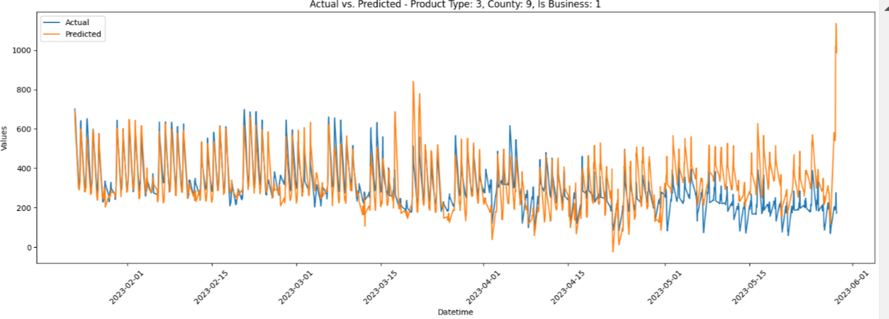
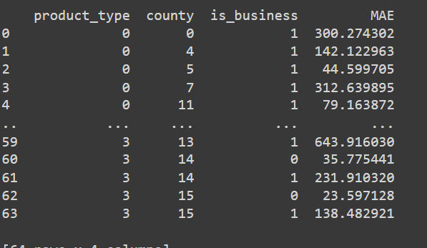
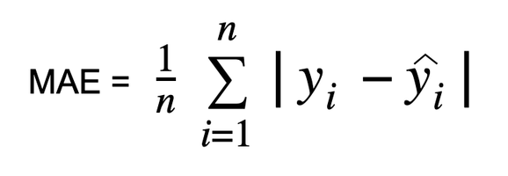
2/ evaluation
In my case I use mean_absolute_error to evaluate

Slide 33
2/ LSTM
1. architechture
2.evaluation
3.challenge
source : Article Predicting Energy Consumption Using LSTM, Multi-Layer GRU and Drop-GRU Neural Networks Sameh Mahjoub 1,2,* , Larbi Chrifi-Alaoui 1 , Bruno Marhic 1 and Laurent Delahoche 1

Slide 34
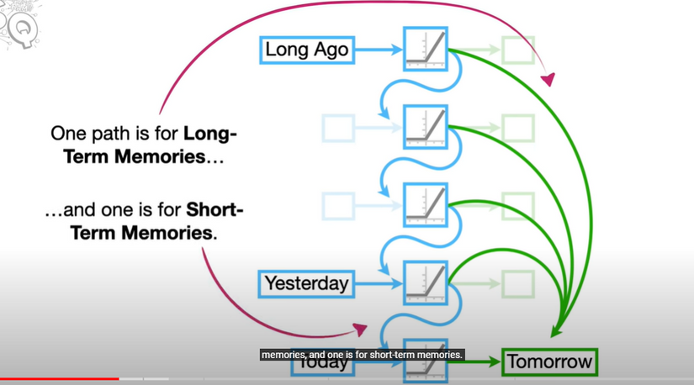
1/ Architechture
The Long Short-Term Memory (LSTM) model is a variant of the Recurrent Neural Network (RNN) designed to retain long-term information. It achieves this through memory units that update previous hidden states and provide feedback at each neuron. Unlike standard RNNs, whose output depends solely on the current input and weight, LSTM also considers past inputs, allowing it to grasp long-term temporal relationships. This model addresses the challenges of exploding and vanishing gradients found in conventional RNNs through its unique internal architecture, which includes an input gate, an output gate, a forget gate, and cell status. These components manage and update the cell's information, enhancing the model's ability to maintain and manipulate long-term memory.

Slide 35
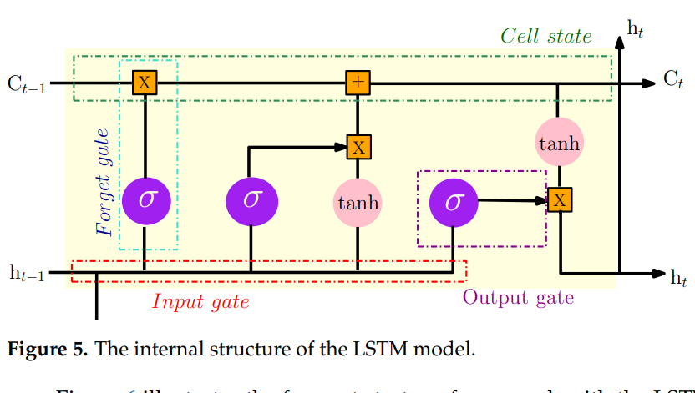
1/ Architechture
The input layer is mainly used for preprocessing the original data;
• The hidden layer is used to optimize the parameters and training the data;
• The output layer is used to predict the data according to the model trained in the
hidden layer.

Slide 36
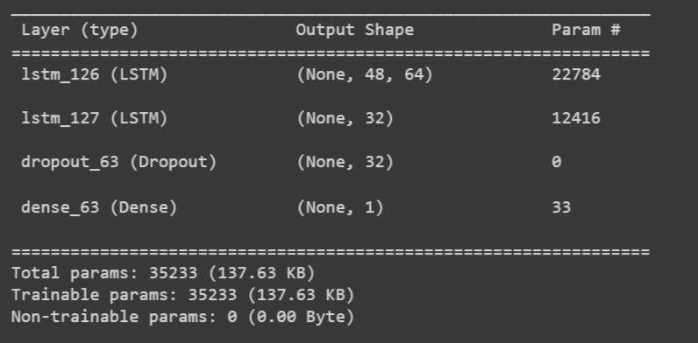
1/ Architechture

Slide 37
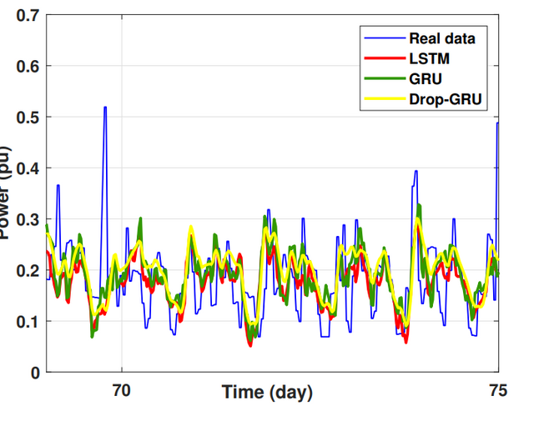
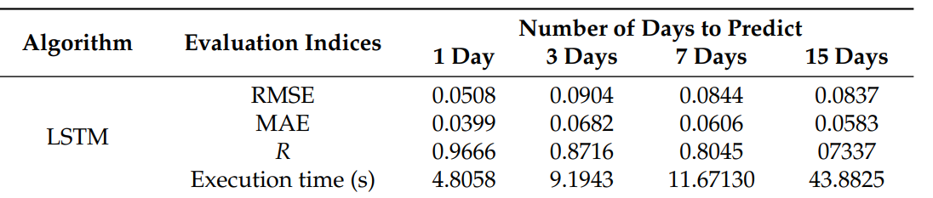
2/ evaluation
RMSE = s 1 N n ∑ i=1 (yi − y˜i) 2
MAE = ∑ n i=1 |yi − y˜i | N
R = cov(yi , y˜i) σyi σy˜i

Slide 38
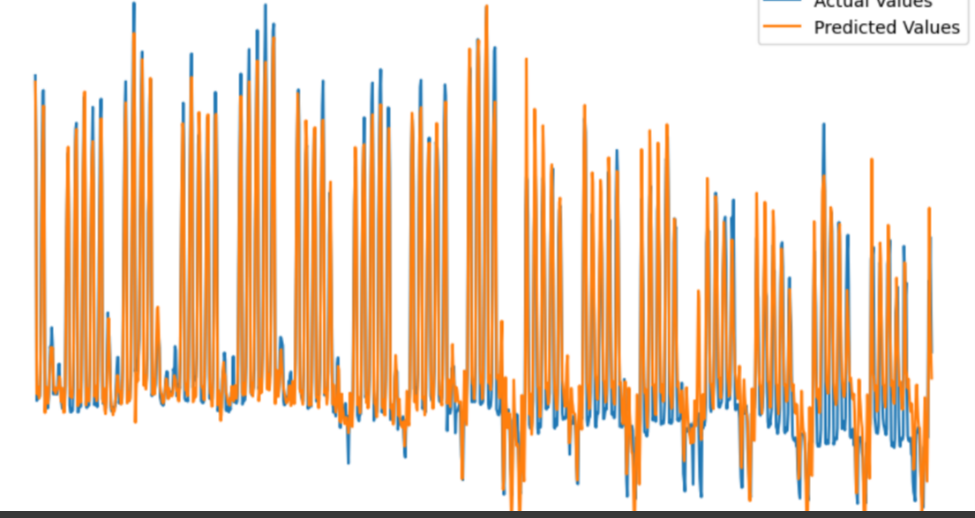
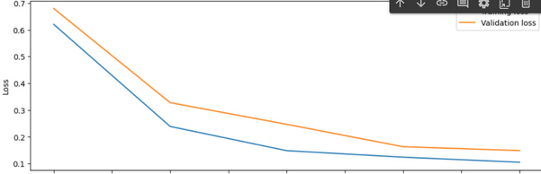
2/ Evaluation

Slide 39
3/ challenges
Sequence Length Determination: Deciding on the appropriate sequence length for training the LSTM model is crucial. If the sequence is too short, the model might not capture long-term dependencies. Conversely, very long sequences can lead to increased computational cost and the potential for overfitting.
Hyperparameter Tuning: Finding the optimal set of hyperparameters (e.g., number of LSTM layers, number of units per layer, learning rate) is a challenging and time-consuming process. It usually requires extensive experimentation or automated methods like grid search or Bayesian optimization.
Model Interpretability: LSTMs, like many deep learning models, can be seen as "black boxes," making it difficult to understand how they make predictions. This poses challenges for model interpretability and for providing insights into the driving factors behind the model's forecasts.

Slide 40
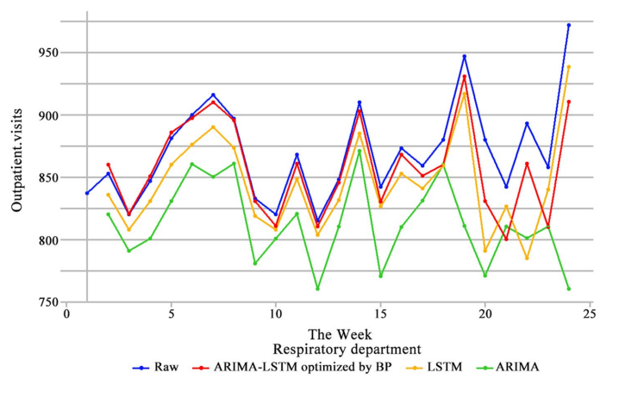
ARIMA & LSTM ?
source : Article A hybrid ARIMA‑LSTM model optimized by BP in the forecast of outpatient visits Yamin Deng1,2 · Huifang Fan1 · Shiman Wu

Slide 41

kanban board

Slide 42
Thank You!

Slide 43
1/ Architechture
ft = σ(wf[ht−1, Xt] + bf) (6)
it = σ(wi[ht−1, Xt] + bi) (7)
ot = σ(wo[ht−1, Xt] + bo) (8)
at = tanh(wa[ht−1, Xt] + ba) (9)
ct = ft ∗ ct−1 + it ∗ at (10)
ht = ot ∗ tanh(ct), (11)
where σ is the sigmoid activation function and it can be defined as:
σ(x) = (1 + e−x)−1. (12)
The notations ft
, it and ot are the output values of the forget, the input and the output
gates, respectively. ct refers to the memory cell and at
is the update and the activation of
the current cell status. Xt
is the input vector and ht represents the output vector result at
time t. Finally, Wf ,i,a,o are the weights matrices and bf ,i,a,o
the bias vectors.

